Slide 1

Data Analysis for Diabetes Prediction Using Health Indicators
Machine Learning

Slide 2
Introduction
The dataset contains detailed health indicators collected from a large population and is designed to support the analysis and prediction of diabetes risk.
The main variable of interest is Diabetes binary, which indicates whether an individual has been diagnosed with diabetes (1) or not (0).
Motivation:
1. How can machine learning models be used to predict diabetes risk more accurately?
Can a subset of factors be used to accurately predict whether an individual has diabetes?

Slide 3
Selection of algorithms for the dataset
MLP (Multilayer Perceptron)
Neural network capable of complex non-linear relationships
Requires tuning of hidden layers and neurons
Handles high-dimensional data well
Autoencoder + Gradient Boosting Classifier
Autoencoder reduces dimensionality and extracts features
Gradient Boosting builds strong predictors from decision trees
Combined approach enhances performance for complex datasets
Naive Bayes
Probabilistic classifier based on Bayes' theorem
Computationally efficient and works well with limited data
Assumes feature independence (may be limiting)

Slide 4
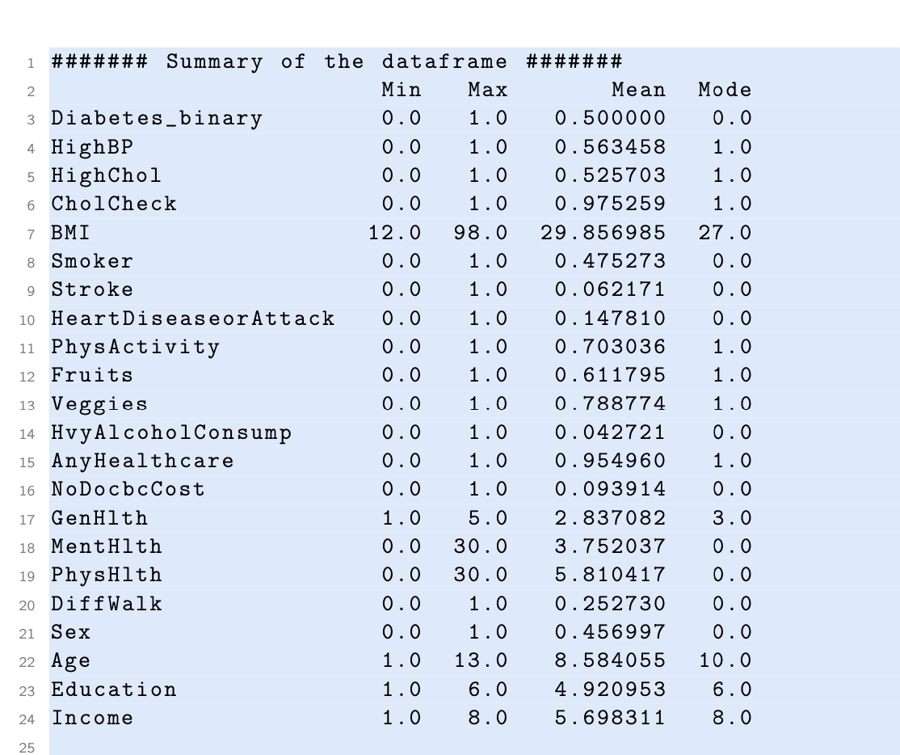
Preprocessing - Data cleaning
Found 1635 duplicate rows , but they are not removed to ensure we preserve all relevant data for analysis.
IQR method flagged 40,205 records as containing at least one outlier attribute—more than half of the dataset.
Z-score method was far more reasonable giving 1927 outliers. We removed them, that left our dataset with 68,765 remaining records for training and testing

Slide 5
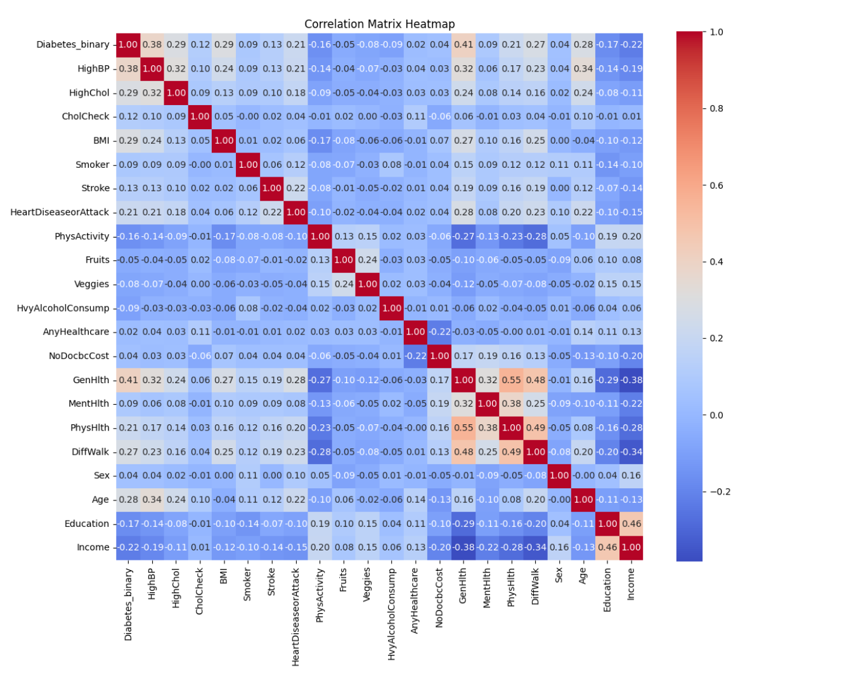
Preprocessing - Correlation
Data integration: all the required data is already combined into a single CSV file.
Data transformation: we apply feature scaling to the dataset in order to standardize the features.
StandardScaler, which standardizes the features by removing the mean and scaling to unit variance.
Correlation between features:
Removal of weakly correlated features
Mitigation of multicollinearity

Slide 6
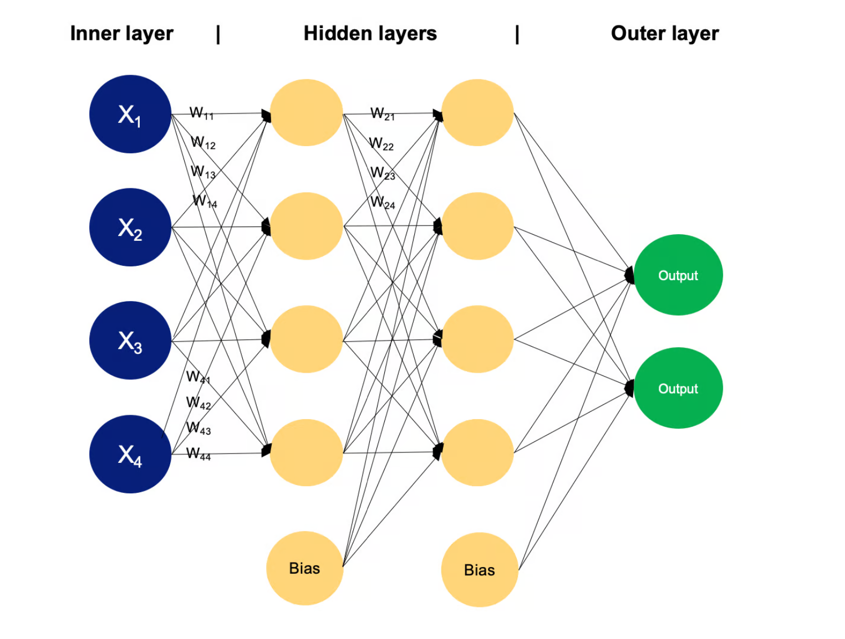
Multilayer Perceptron - Theory
MLP consists of three primary layers: the input layer, one or more hidden layers, and the output layer.
MLPs are particularly effective in tasks where the relationships between input features and the target variable are
non-linear, as is the case in health-related predictions like diabetes classification.

Slide 7
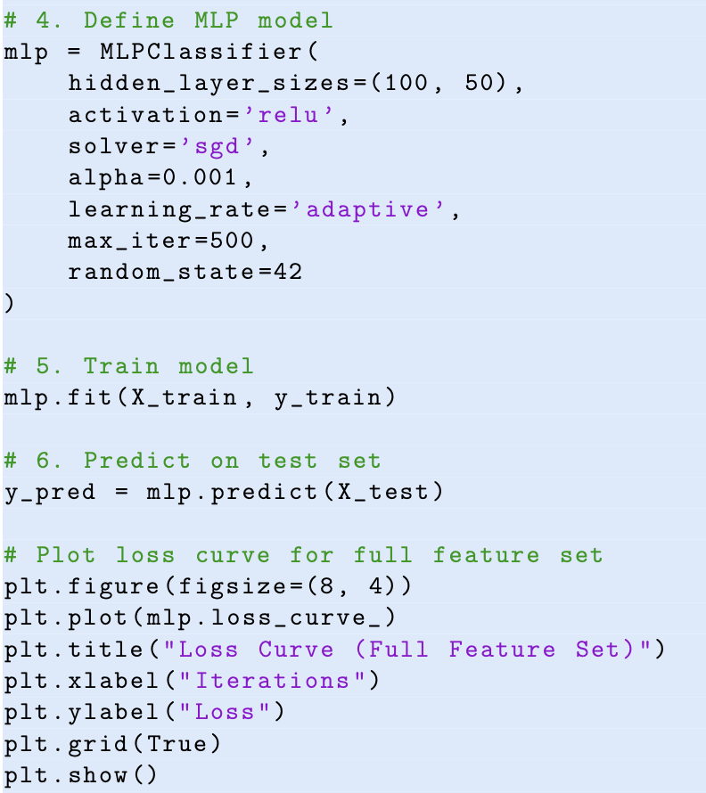
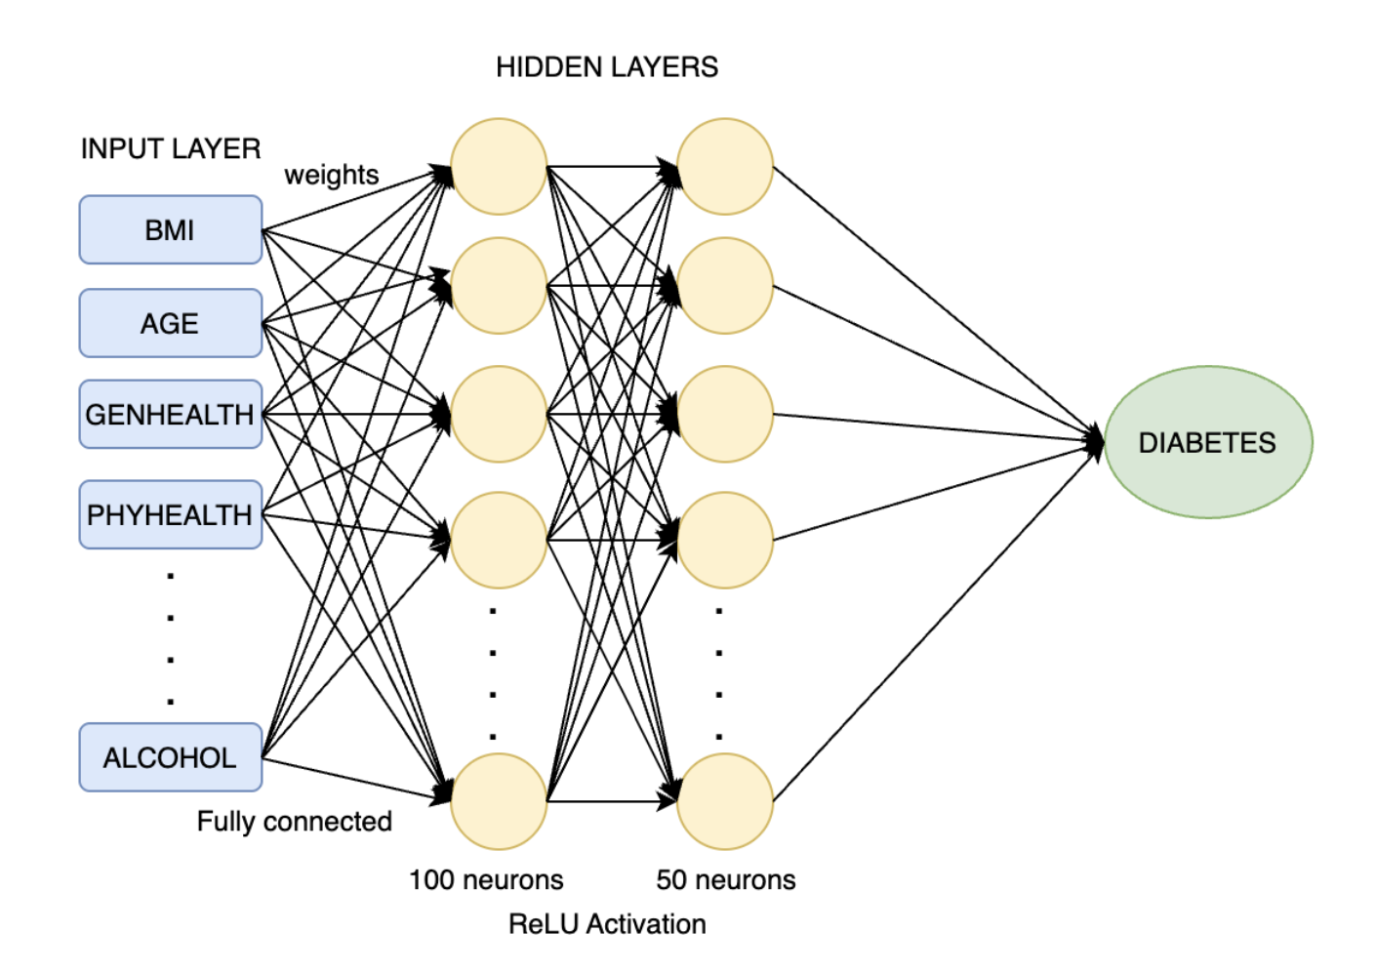
Multilayer Perceptron - Implementation

Slide 8
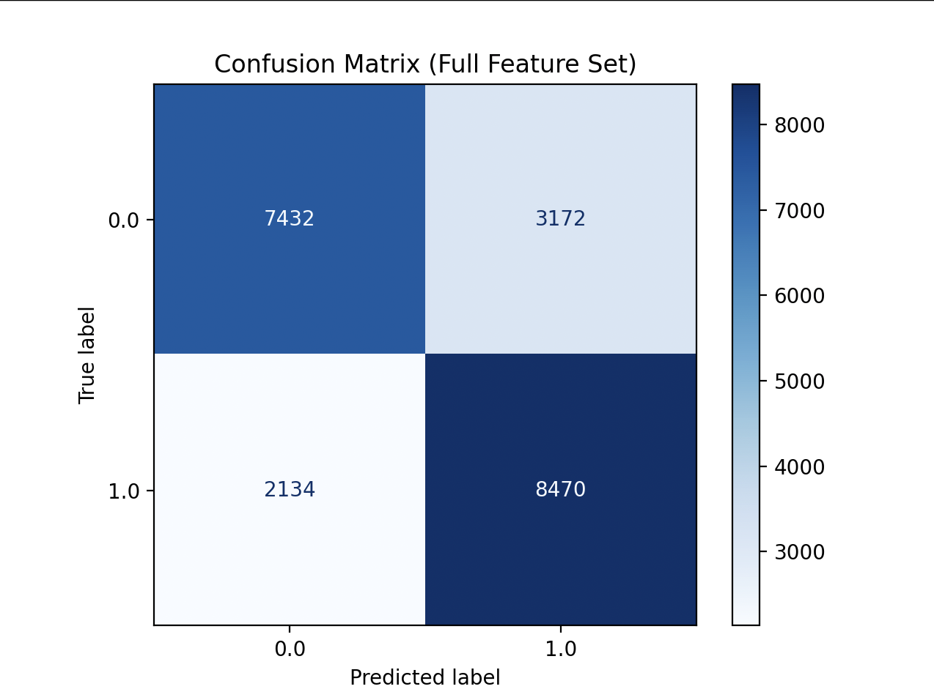
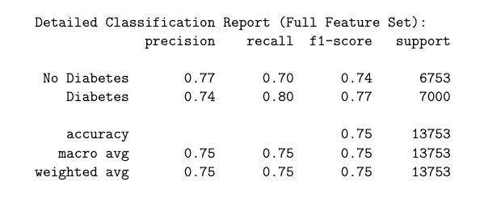
Multilayer Perceptron - Results

Slide 9
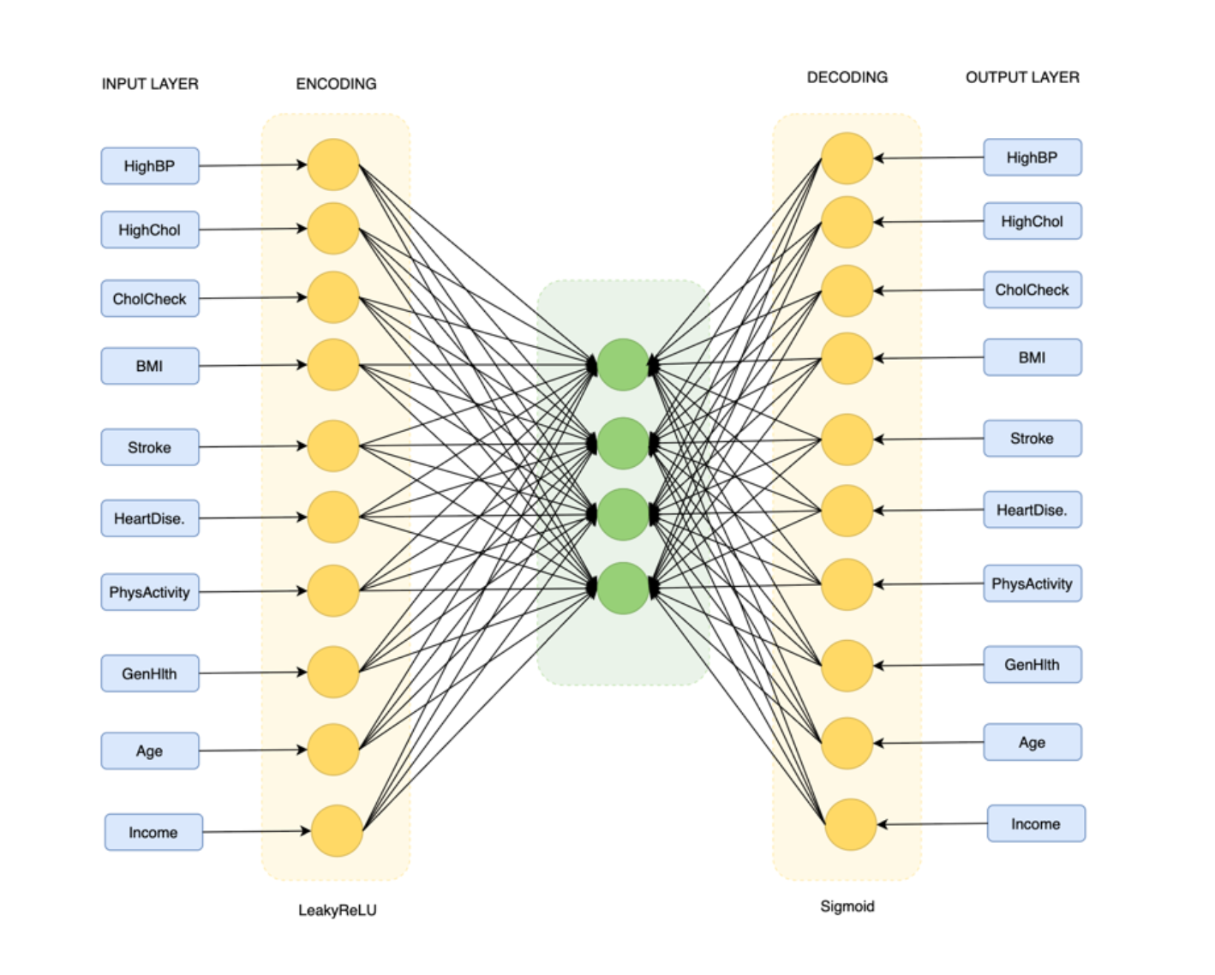
Autoencoder - Theory
Autoencoders are neural networks designed to learn efficient representations of data by compressing input through an encoder, capturing essential features in a compact bottleneck layer, and reconstructing the original data using a decoder.

Slide 10
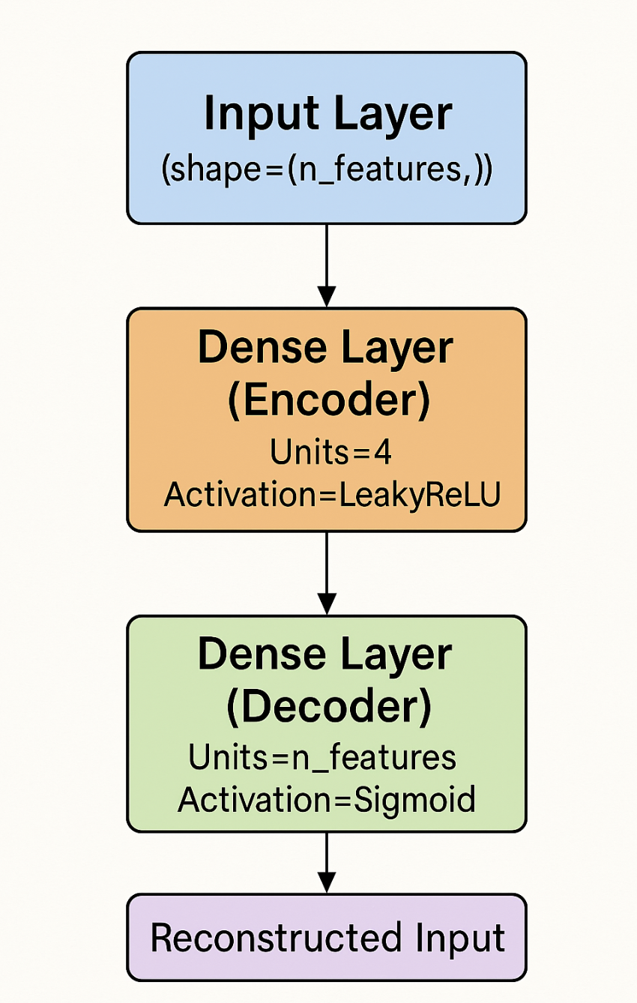
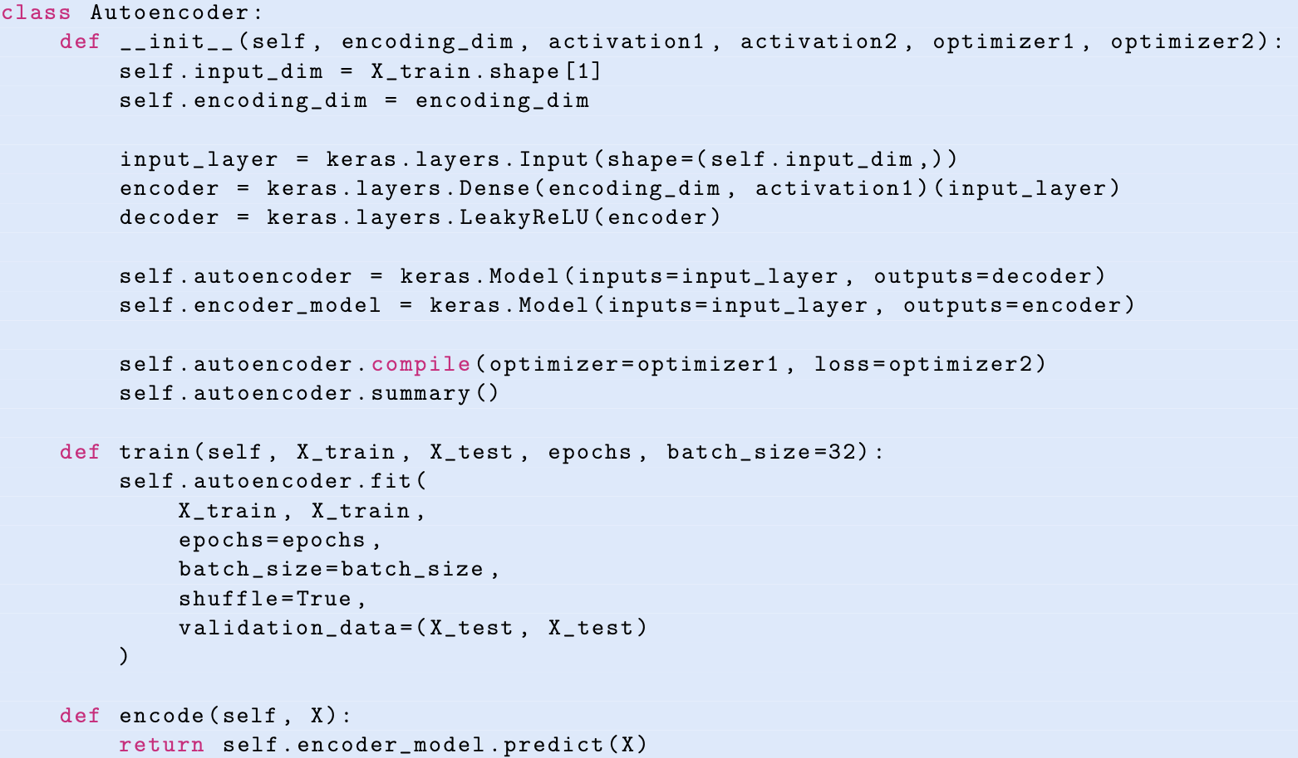
Autoencoder - Implementation

Slide 11
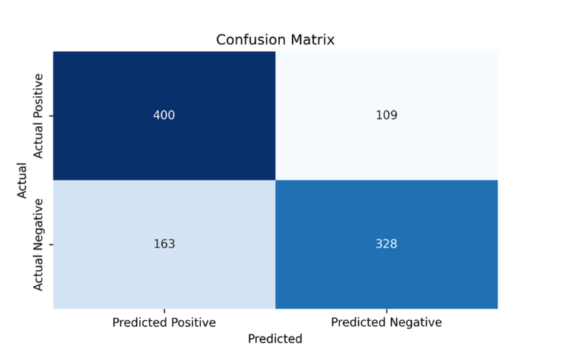
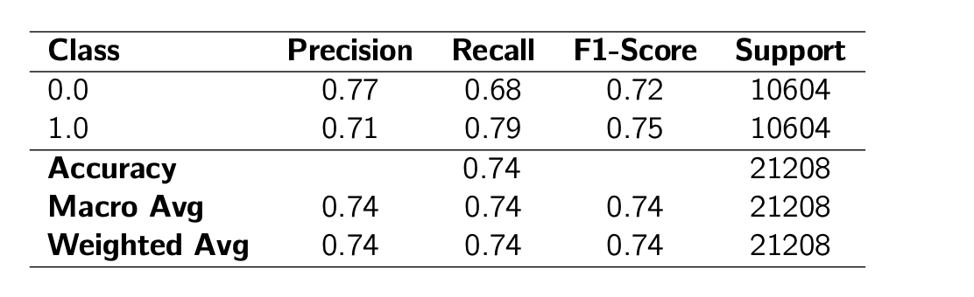
Autoencoder - Results

Slide 12
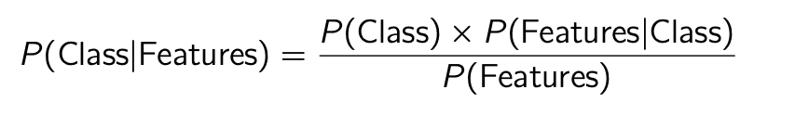
Naive Bayes - Theory
The Naive Bayes algorithm offers a straightforward yet often surprisingly effective approach to supervised learning, particularly for classification tasks like predicting diabetes status.
Variants:
Gaussian Naive Bayes
Multinomial Naive Bayes
Bernoulli Naive Bayes

Slide 13
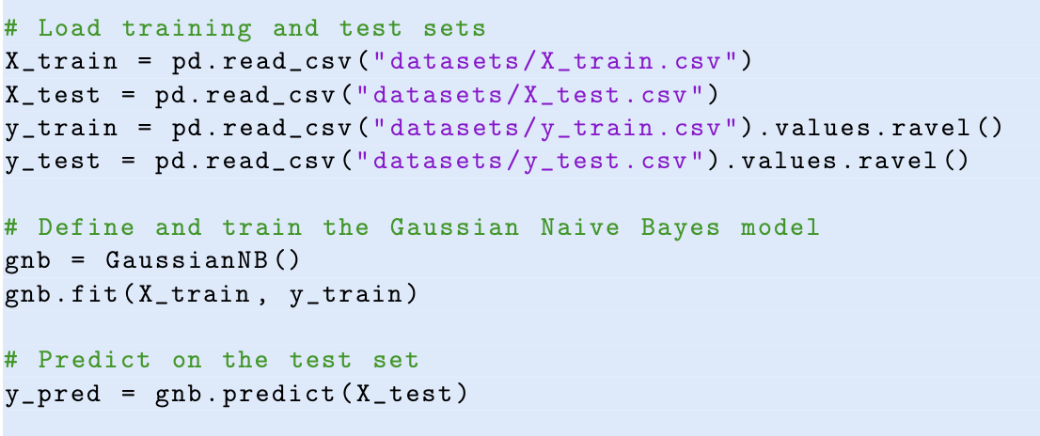
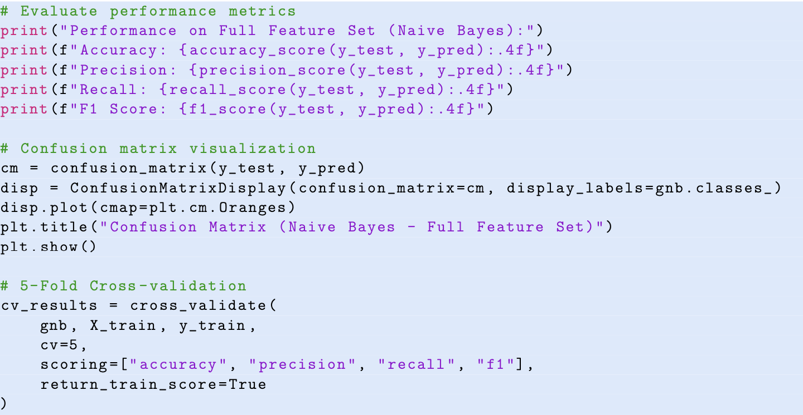
Naive Bayes - Implementation

Slide 14
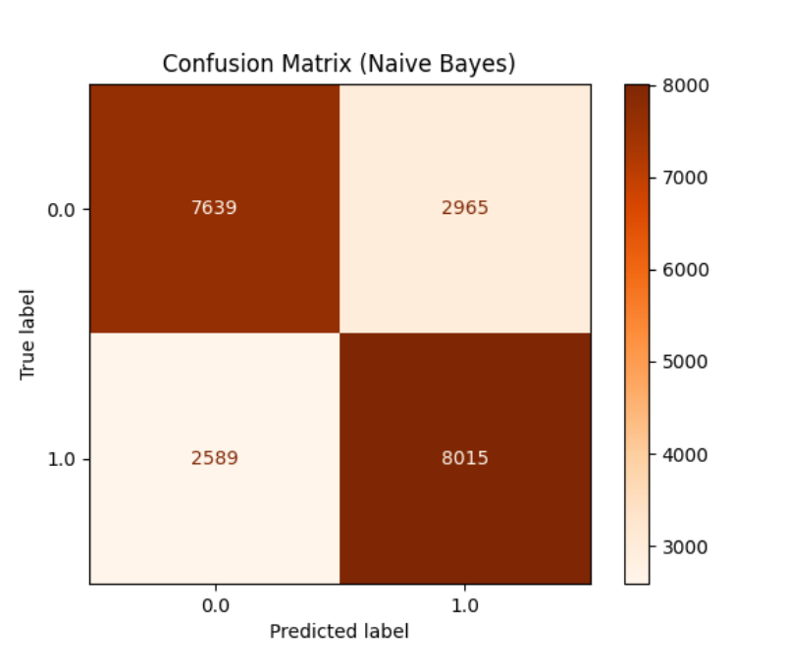
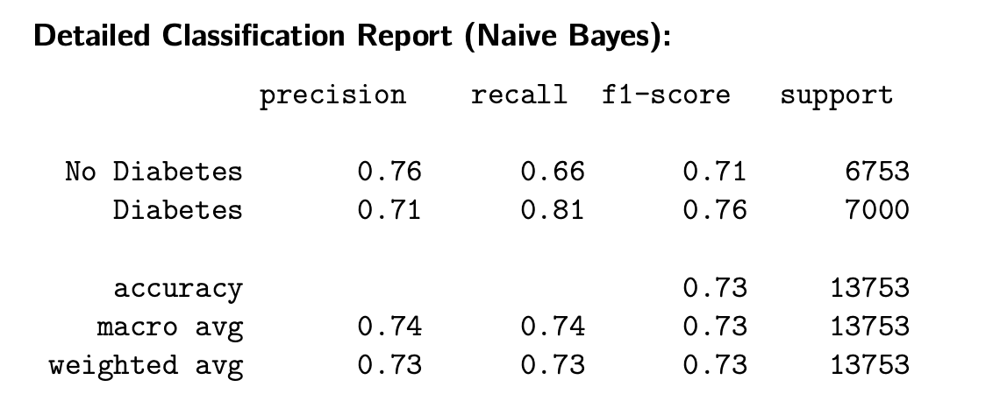
Naive Bayes - Results

Slide 15
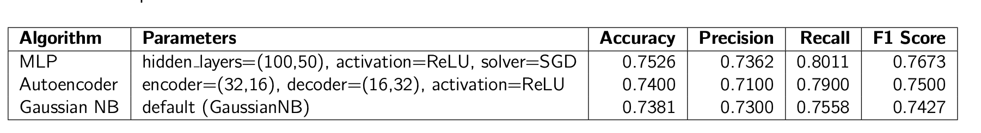
Results & Reasoning
We compare the three applied algorithms—Multilayer Perceptron (MLP), Autoencoder, and Gaussian Naive Bayes—using four key performance metrics: Accuracy, Precision, Recall, and F1 Score.
In a medical setting, missing a true diabetic case (false negative) is far more critical than issuing a false alarm. Thus, we prioritize models with higher recall.
Among the three models evaluated, the Multilayer Perceptron (MLP) demonstrates the best overall performance

Slide 16
Thank you!
Questions?
Albana Rexhepi
Eljesa Kqiku
Kaltrina Kuka

